Slide 1
Unit 4: Lesson 1 & 2- What is Big Data? / Rapid Research - Data Innovations
Day 32

Slide 2
Turn-In Tests
Turn-In graded Tests
Journal Check
Finish Unit 3 Lesson 10 Group Projects
Present Your Group Project
Share GoogleDoc With Coach B

Slide 3
Lesson 1 - What is Big Data?
The explosion in computing power over the last several decades has led to a similarly astounding growth in the amount of data that is transmitted, collected, and analyzed every day.
Nearly every industry and field is making use of data to better understand what is happening around them and develop new and creative solutions to the problems they face.
As the scale of data gets bigger and bigger, new techniques and tools are necessary to be able to meaningfully make use of it.

Slide 4
Lesson 1 - What is Big Data?
Moore's Law- the observation that computing power roughly doubles every two years.
Big Data: a broad term for datasets so large or complex that traditional data processing applications are inadequate.

Slide 5
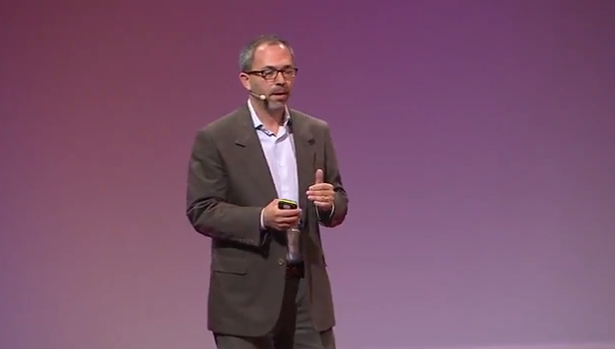
Lesson 1 - What is Big Data?
Video- Big Data is Better Data

Slide 6
Lesson 1 - What is Big Data?
Activity- Big Data Sleuth Card

Slide 7
Lesson 2 - Rapid Research - Data Innovations
In this lesson you will conduct a small amount of research to explore a computing innovation that leverages the use of data. You will research a topic of personal interest and respond to questions about how that innovation produces, uses or consumes data.

Slide 8
Lesson 2 - Rapid Research - Data Innovations
One-pager: A business/corporate term for a one-page document that summarizes a large issue, topic or plan. The purpose is to distill and highlight the most important pieces of information in a digestible manner so that the reader can be quickly acquainted with the relevant details of the "big picture."

Slide 9
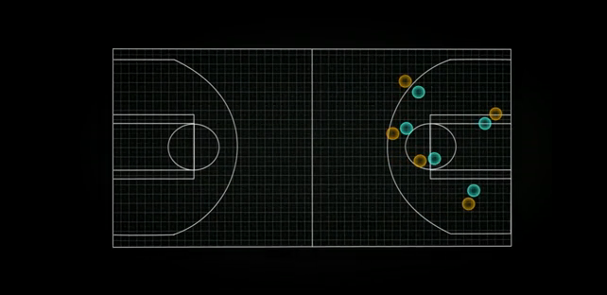
Lesson 2 - Rapid Research - Data Innovations
--VIDEOS—
Code.org – Data and Medicine
TED Talk: The Math Behind Basketball's Wildest Moves

Slide 10
Lesson 2 - Rapid Research - Data Innovations
Activity Guide: Rapid Research - Data Innovations
Worksheet: Data Innovations One-Pager Template

Slide 11
Review / Next Class
Review
Next Class
Quiz Tuesday

